Slide 1
AI for Human Resources
Hire fairer · understand your data · scale support safely
DEVELOPERS INSTITUTE

Slide 2
Where AI fits in HR
Recruit
Understand
Scale
Draft posts, rubrics,
fair questions
Read files, forecast,
analyse surveys
Agents for
repeat questions
AI takes the routine work so you focus on people. Adoption in HR jumped from ~26% to ~43% in a year.
DEVELOPERS INSTITUTE

Slide 3
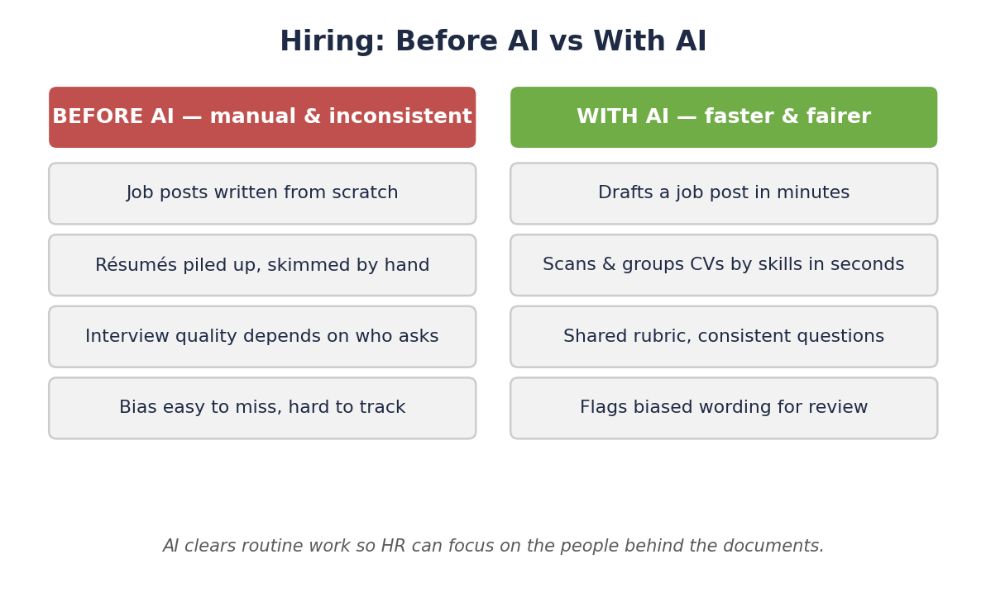
Faster and fairer hiring
AI clears routine work; your judgment keeps it fair.
DEVELOPERS INSTITUTE

Slide 4
From job post to fair interview
1. Draft & de-bias
the job post
➜
2. Build a
1–5 rubric
➜
3. Behaviour-based
questions
AI flags · humans approve
DEVELOPERS INSTITUTE

Slide 5
Grounding: answer from YOUR documents
Give AI approved files (handbook, policies, surveys) so answers come from your data — not generic guesses.
Input
Approved docs, spreadsheets, contracts
AI role
Summarise, compare, flag risk
Output
Grounded, checkable answers
DEVELOPERS INSTITUTE

Slide 6
The guardrails that matter
• AI learns from the past — bias can carry forward
• Never upload PII to unapproved tools
• GDPR / CCPA still apply
• Anonymise while exploring
Scrapped
Amazon's biased résumé tool, after it penalised “women's”.
DEVELOPERS INSTITUTE

Slide 7
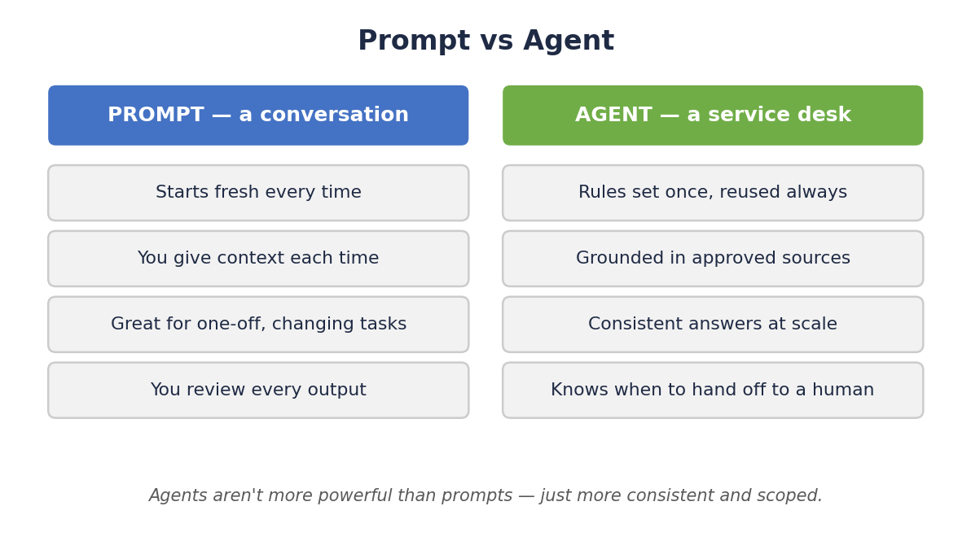
Prompt vs Agent
Prompt = a conversation. Agent = a service desk. Use an agent when questions repeat and consistency matters.
DEVELOPERS INSTITUTE

Slide 8
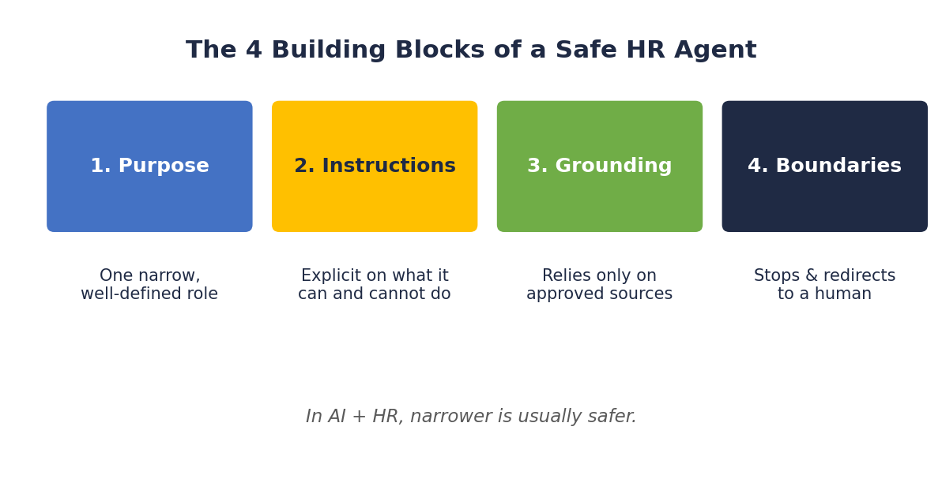
Designing a safe HR agent
In AI + HR, narrower is usually safer.
DEVELOPERS INSTITUTE

Slide 9
Key Takeaways
1
AI drafts and surfaces — humans check for bias and decide.
2
Ground AI in approved documents; protect PII under GDPR/CCPA.
3
Prompt for one-off work; agent for repeat, consistency-critical work.
4
Agents need maintenance — a monthly review catches drift.
DEVELOPERS INSTITUTE

Slide 10
Questions?
DEVELOPERS INSTITUTE

